Slide 1
Final Project : Shopping Cart Application
By
Vaidehi Patki & Bharath Reddy & Hengfu Wu
Under the direction of
Mr. Louis Henry

Slide 2
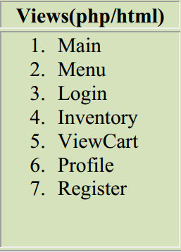
MVC---Views

Slide 3
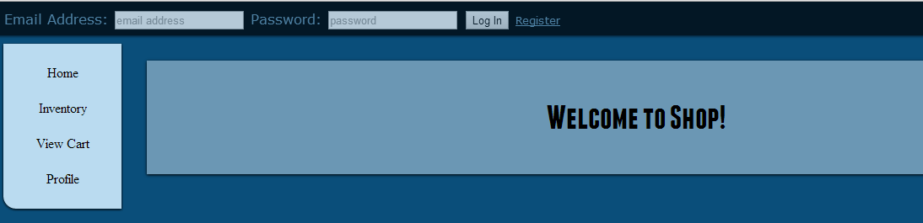
MVC---Views

Slide 4
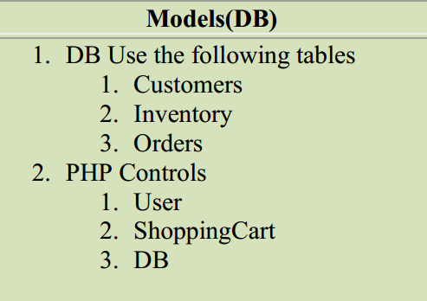
MVC---Models

Slide 5
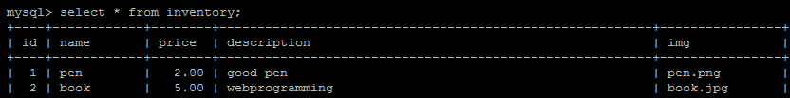
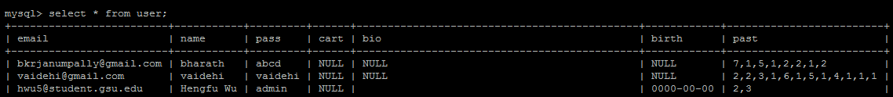
MVC---Models

Slide 6
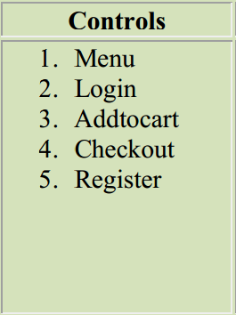
MVC---Controls

Slide 7
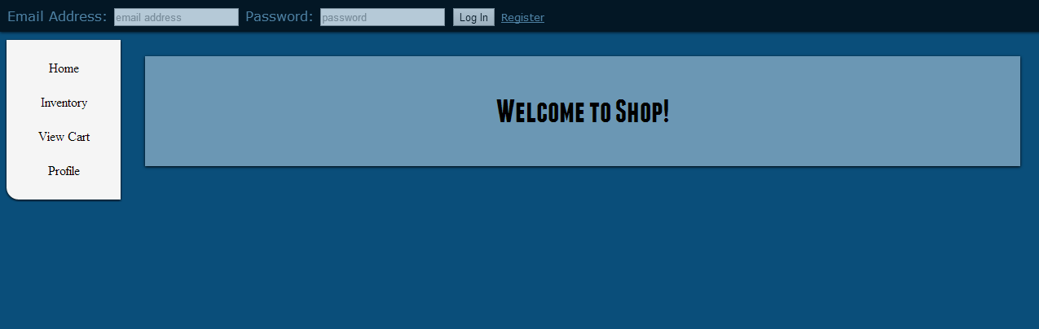
MVC---Main

Slide 8
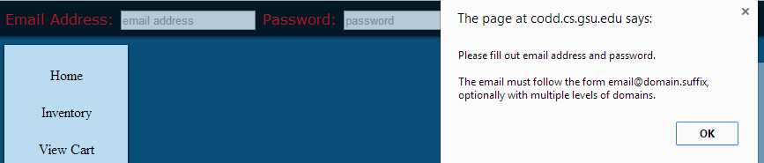
Login Page
Successfully login!
Empty input?
Wrong password?

Slide 9
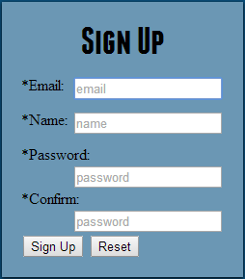
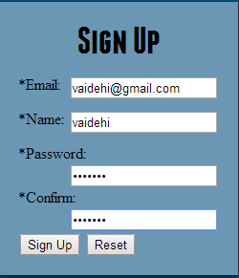
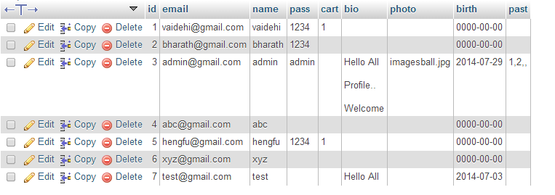
Register
Successfully register
Record in database

Slide 10
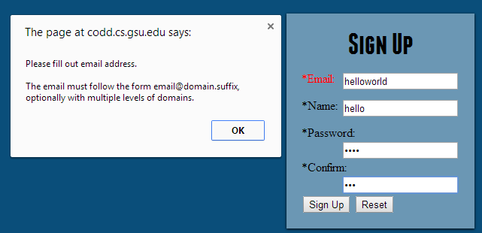
Register
Wrong format register

Slide 11
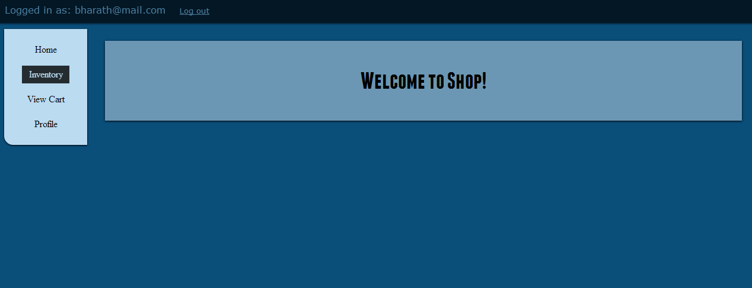
After Login:

Slide 12
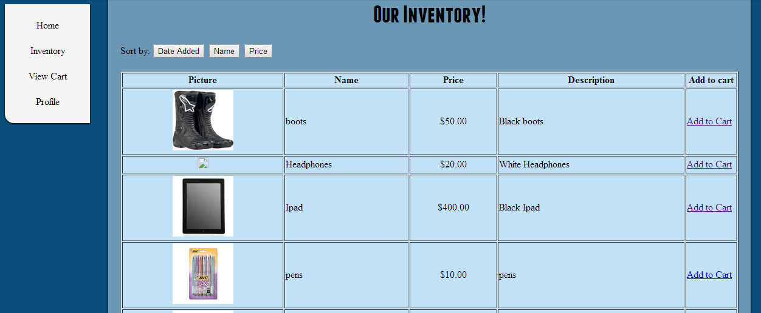
Inventory

Slide 13
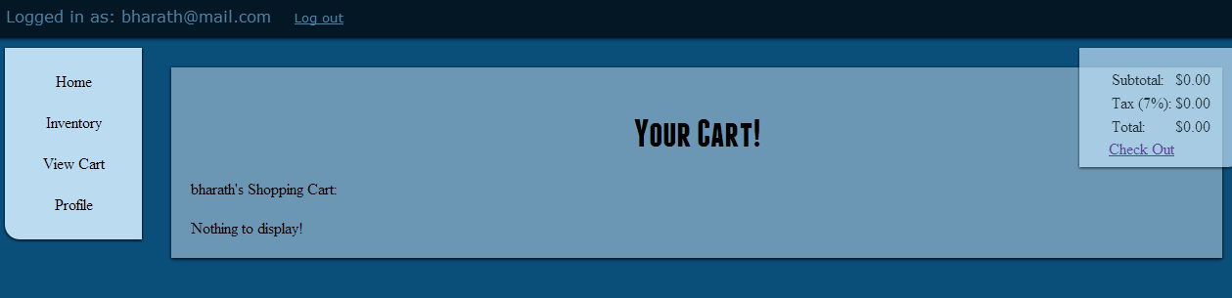
View Cart

Slide 14
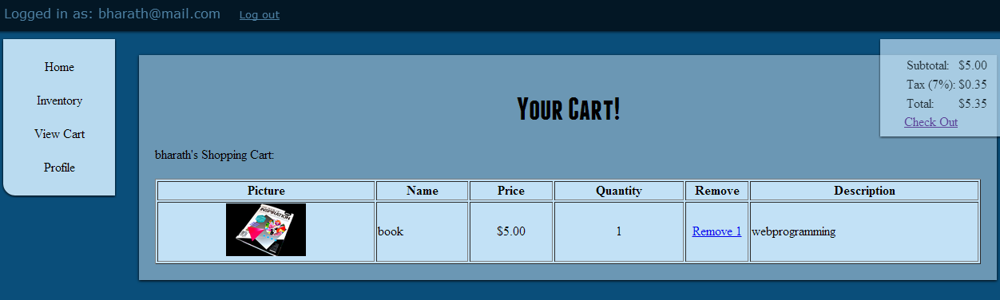
View Cart after ordering the Product

Slide 15
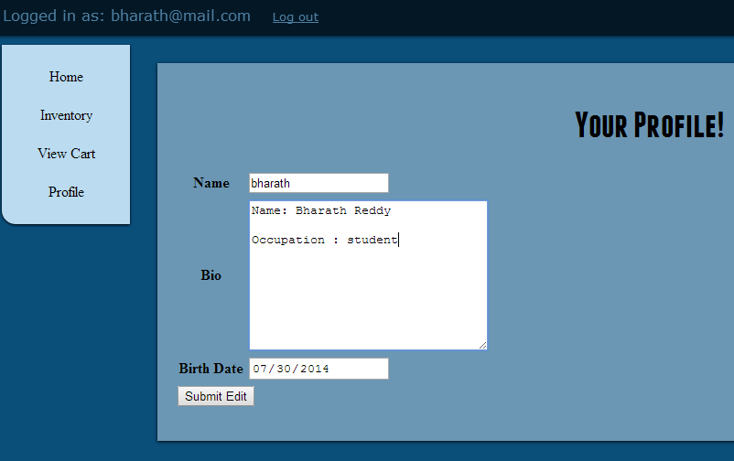
Profile

Slide 16
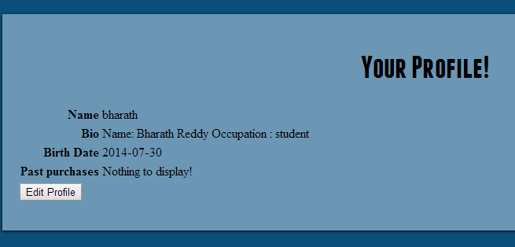
Profile Update

Slide 17
Project Link:
Thank You!!!
http://codd.cs.gsu.edu/~csc4370SU14_22/shopcart/index.php

